Slide 1



Solution of the quizz
MobileNets
Master in Big Data Solutions 2020-2021 - Artificial Intelligence
Xavier Giró
xavier.giro@bts.tech

Slide 2
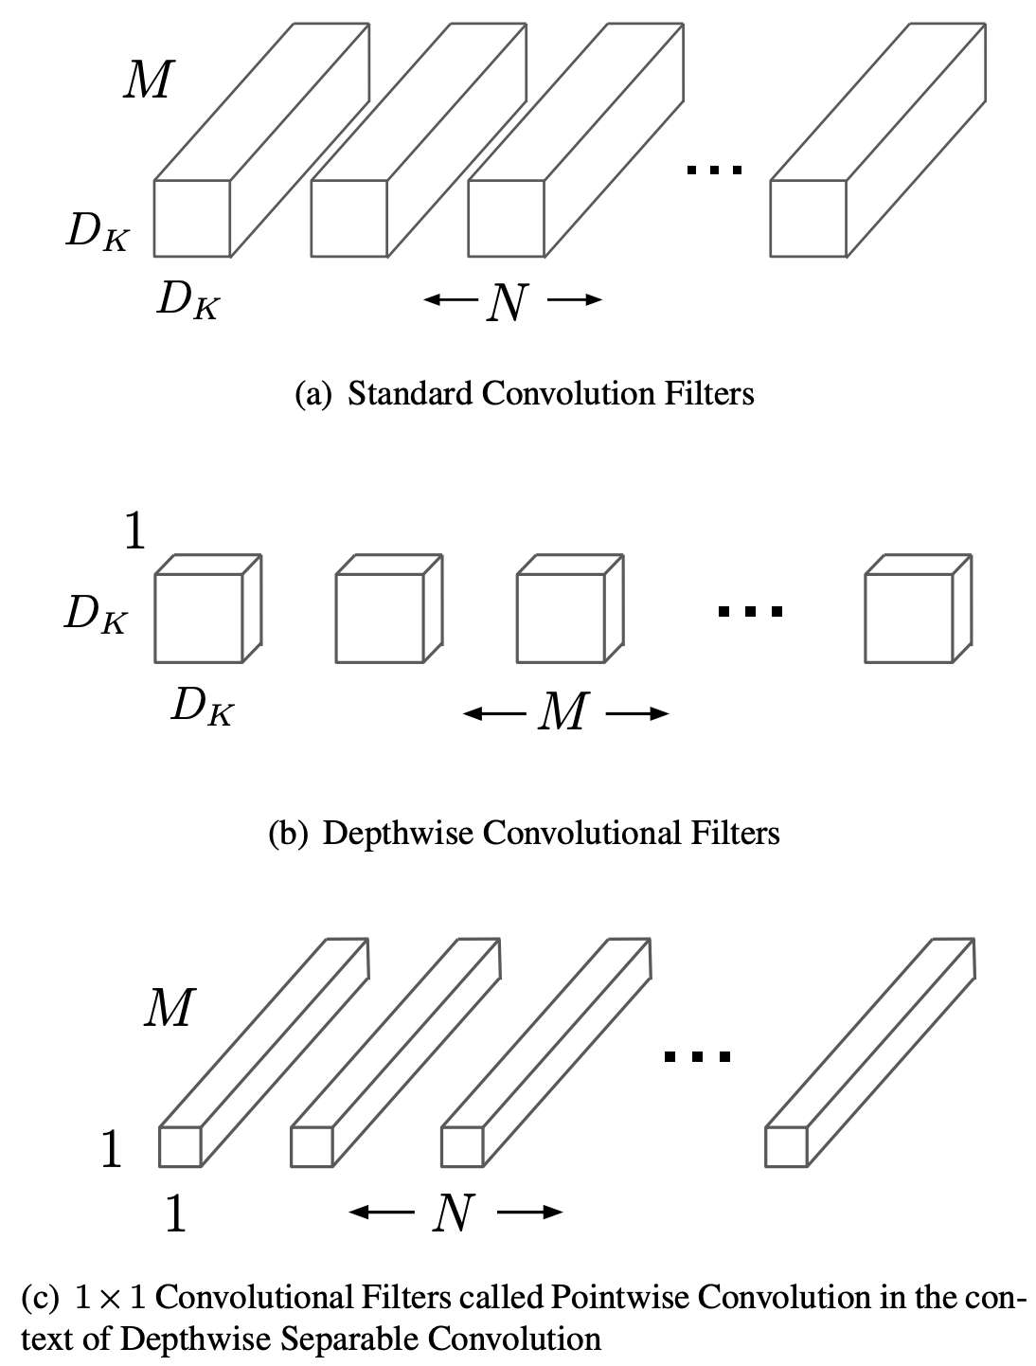
Standard convolutions
Consider:
An input tensor of 14x14x512.
A standard 2D convolutional layer that contains 512 filters of kernel size 3x3x512 with stride 1 and padding.
How many multiplications are required to compute the whole output tensor ?
Standard Convolutions:
( 3 x 3 x 512 ) x ( 14 x 14 ) x 512 = 462.4M
#MobileNet1 Howard, A. G., Zhu, M., Chen, B., Kalenichenko, D., Wang, W., Weyand, T., ... & Adam, H. (2017). Mobilenets: Efficient convolutional neural networks for mobile vision applications. arXiv preprint arXiv:1704.04861. [blog]

Slide 3
Depth-wise Convolutions
Consider an alternative configuration:
An input tensor of 14x14x512.
A depth-wise convolutional layer with 512 filters of kernel size 3x3x1 with stride 1 and padding.
What is the dimension of the output tensor ?
( 14 x 14 ) x 512 (same as input)
#MobileNet1 Howard, A. G., Zhu, M., Chen, B., Kalenichenko, D., Wang, W., Weyand, T., ... & Adam, H. (2017). Mobilenets: Efficient convolutional neural networks for mobile vision applications. arXiv preprint arXiv:1704.04861. [blog]

Slide 4
Depth-wise + Point-wise Separable Convolutions
In order to allow the interaction across the channels of the input tensor, an additional layer of point-wise (1x1x512) convolutions is added.
How many point-wise convolutional kernels are needed to keep the same dimensions at the output tensor ?
Point-wise Convolutions
(1 x 1 x 512 ) x ( 14 x 14 ) x 512=51.3M
#MobileNet1 Howard, A. G., Zhu, M., Chen, B., Kalenichenko, D., Wang, W., Weyand, T., ... & Adam, H. (2017). Mobilenets: Efficient convolutional neural networks for mobile vision applications. arXiv preprint arXiv:1704.04861. [blog]

Slide 5
Depth-wise + Point-wise Separable Convolutions
How many multiplications does the concatenation separable + point-wise convolutions layers require ?
Compare the amount of multiplications with the ones required in the standard 2D convolutions.
Depth-wise convolutions Point-wise Convolutions
( 3 x 3 ) x ( 14 x 14 ) x 512=903k
512 x ( 14 x 14 ) x 512=51.3M
#MobileNet1 Howard, A. G., Zhu, M., Chen, B., Kalenichenko, D., Wang, W., Weyand, T., ... & Adam, H. (2017). Mobilenets: Efficient convolutional neural networks for mobile vision applications. arXiv preprint arXiv:1704.04861. [blog]

